Slide 1
Semantic Interoperability Guide Generator (SIGG)
Accomplishments
February 9, 2017

Slide 2
SIGG : Executive Summary
Semantic Interoperability Guide Generator (SIGG)
Defines the shared semantics between alternative logical models, interoperability formats, and legacy data
FHIM, HL7 FHIR, C-CDA, VA eHMP and DoD DES data
Employs a common “Referent Index” canonical model
Clear and unambiguous content for:
Standards developers
Interoperability solution implementers
Scalable and maintainable methodology & tooling
UML information models leveraging MDHT
Model-to-model MDMI framework
Model-to-text report generation component
Notes:
Successful proof of concept (PoC) employing a common logical/clinical model to define the shared semantics between alternative interoperability formats
PoC Scope: JET allergen use case as defined by DoD/VA FHIR proving task force
Scalable and maintainable approach was developed and employed that provided clear and unambiguous content for standards developers and interoperability solution implementers
Reusable and extensible deliverables of PoC include:
Model to Text report generation component
Model to Model MDMI Framework
Canonical form, a natural unique representation of an object, or a preferred notation for some object

Slide 3
SIGG – Software Services & Tooling
Clinical Models
Interoperability Standards
Data Sources
Information Models
(MDHT)
Referent Index
Interoperability
Models
(MDMI)
SIGG Core Software Services
Reusable Artifacts
MDHT Model Editor
MDMI Model Editor
Model-to-Model Transform
Runtime
Data Transform
Traceability and Gap Analysis
Profile
Generator
SIGG Tooling

Slide 4
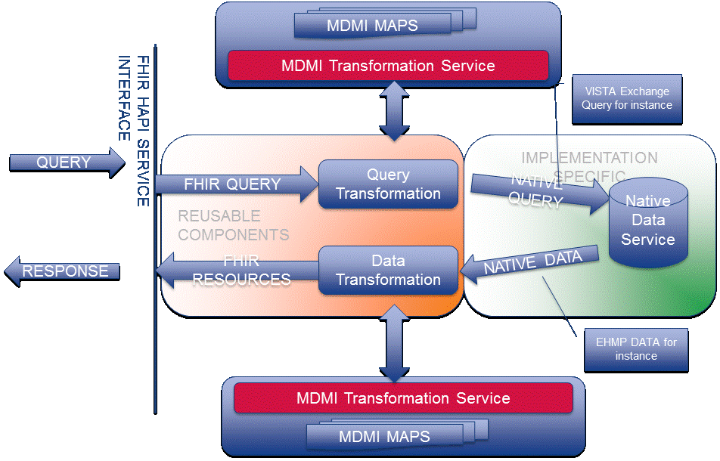
SIGG Based FHIR Server for JET IPO

Slide 5
FHA SIGG/IPO Activities
Collaboration with the IPO JET FHIR Proving Ground (FPG)
Development, testing, and integration of SIGG process and tooling
Definition of the shared semantics and mapping between alternative data models
FHIM logical model
HL7 FHIR Data Access Framework (DAF) profiles and resources
VA data source: eHMP Virtual Patient Record (VPR)
DoD data source: CDR via DES services
C-CDA data source: from any healthcare provider
Reusable and extensible process and tooling
Business and semantic element definitions (Referent Index)
Mapping to data sources
Traceability and Gap Analysis report generated from mapping
Prototype for platform integration
Mapping VA/DoD query services to HL7 FHIR standard queries
Integrate SIGG mapping into the IPO prototype FHIR server

Slide 6
SIGG Deliverable Highlights
MDMI Maps and corresponding Analysis Reports
HL7 FHIR DSTU2, VA eHMP, DoD DES
HAPI FHIR Components
MDMIProvider using Java Generics
FhirResourceService – Core service definition which gets native data and transforms based on requested component
MDMI Transformation Service
Cloud-based service
FHIR STU3 Terminology Services for Translation
Translate source/target coded values using FHIR ConceptMap

Slide 7
SIGG Deliverable Highlights
SIGG Tooling Updates
MDMI Data type Mapping
FHIR Terminology Transformation Integration
New Coverage report
Query Transformation Prototype

Slide 8
FHA SIGG and the FPG JET IPO Project
What the SIGG accomplished
Produced initial mappings (DES to FHIR, eHMP to FHIR) for 7 clinical sections in the Argonaut Sprints
Generated spreadsheets for SMEs to review
Integrated tooling into existing IPO test environment
Added additional capabilities based on FPG requirements and enhancements to SIGG for DES/eHMP patterns
FHIR terminology service
Prototype SIGG Query Transformation (FHIR to eHMP)
User Productivity: Mapping Datatypes for record-oriented structures
Tests being run now in the IPO Testbed
Will use an agile approach based on SME review of generated spreadsheets
Resources
The SIGG-FHA FPG JET team was 1 Business Analyst and 1 Integration Engineer. Total development ~ 1/3 FTE throughout the August 2016 - January 2017 timeframe

Slide 9
Deliverable: Mappings and Generated SME Spreadsheets
Generated Coverage Reports and Gap and Traceability Reports for DES, eHMP, FHIR. Example report: eHMP to FHIR Allergy Intolerance Traceability Report
Utilizing spreadsheet format for human readability

Slide 10
SIGG Development Status Summary
IPO
Testing to be completed in February for both VA and DoD. On track for meeting Project Objectives
SIGG
Total development ~ 1/3 FTE throughout the August 2016 - January 2017 timeframe
Additional development is on hold at this time

